Slide 1

University of Wisconsin Madison
Business Analysis
on
NAIQING CAI
JITIAN ZHAO
ZIHAO LI
YAOBIN LING
STAT 628 Module 3
PRESENTED BY GROUP 2

Slide 2

University of Wisconsin Madison
CONTENTS
Data Analysis Plan
Preliminary Analysis
PART ONE
PART TWO

Slide 3
University of Wisconsin Madison
Data Analysis Plan
PART ONE

Slide 4
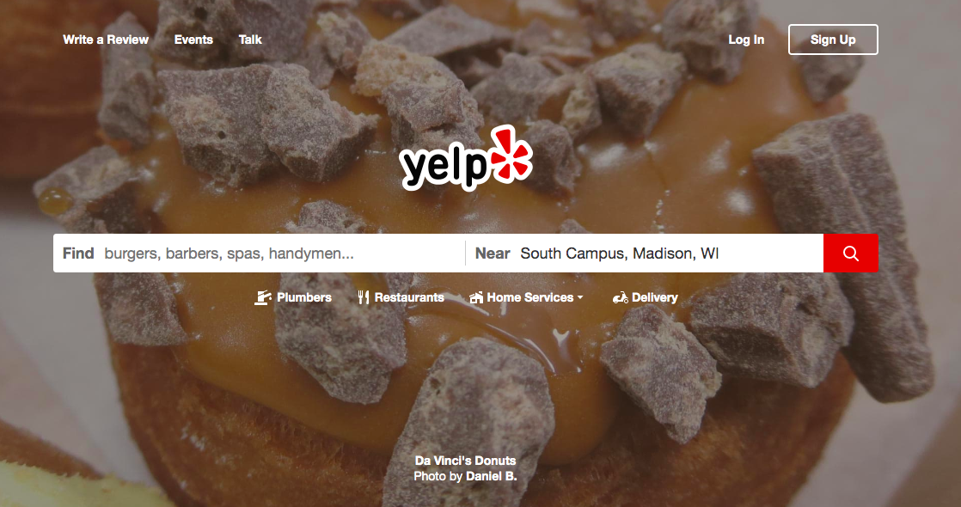
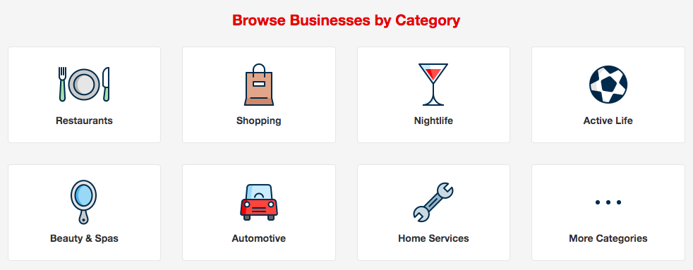
PART ONE Data Analysis Plan
Background
Information in Data
Statistical Analysis
Data-driven and Actionable Decisions

Slide 5
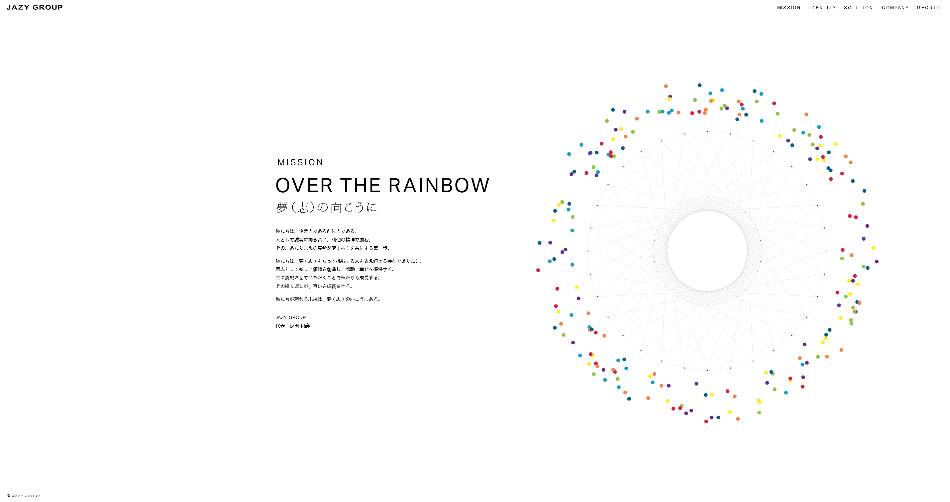
PART ONE Data Analysis Plan
Identify Business Problems
Goal
Data
Data-driven and Actionable Decisions
Restaurant——Bars

Slide 6
PART ONE Data Analysis Plan
Step 1 Data Preprocessing
Step 3 Learning Algorithm
Step 5 Application
Data Overview
Text Cleaning
Data Visualization
Shiny App
Decision Making
Topic Modeling——LDA
WORK FLOW
Step 2 Feature Extraction
Step 4 Model Evaluation
TF-IDF
Performance Metrics
Diagnostics

Slide 7
University of Wisconsin Madison
Preliminary Analysis
PART TWO

Slide 8
Data Overview——Data Structure
PART TWO Preliminary Analysis
Business
Business id | is_open | categories | Attributes | Address City & State Postal code Latitude & Longitude | Stars
Review
Review id | User id | Business id | stars | useful | funny | cool | text
User
User id | Review count | Start & Elite | useful | funny | cool | fans | friends
Tip
User id | Business id | text

Slide 9
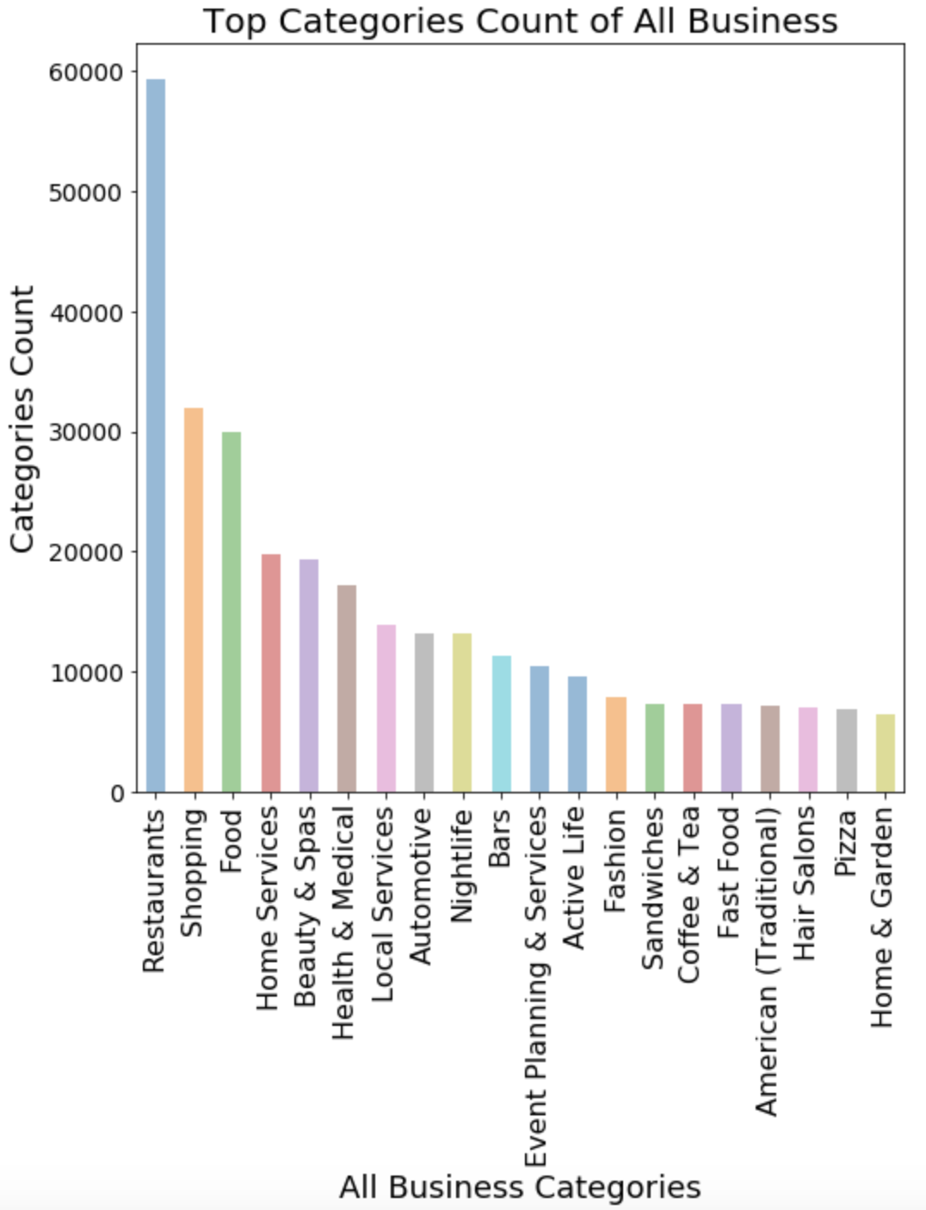
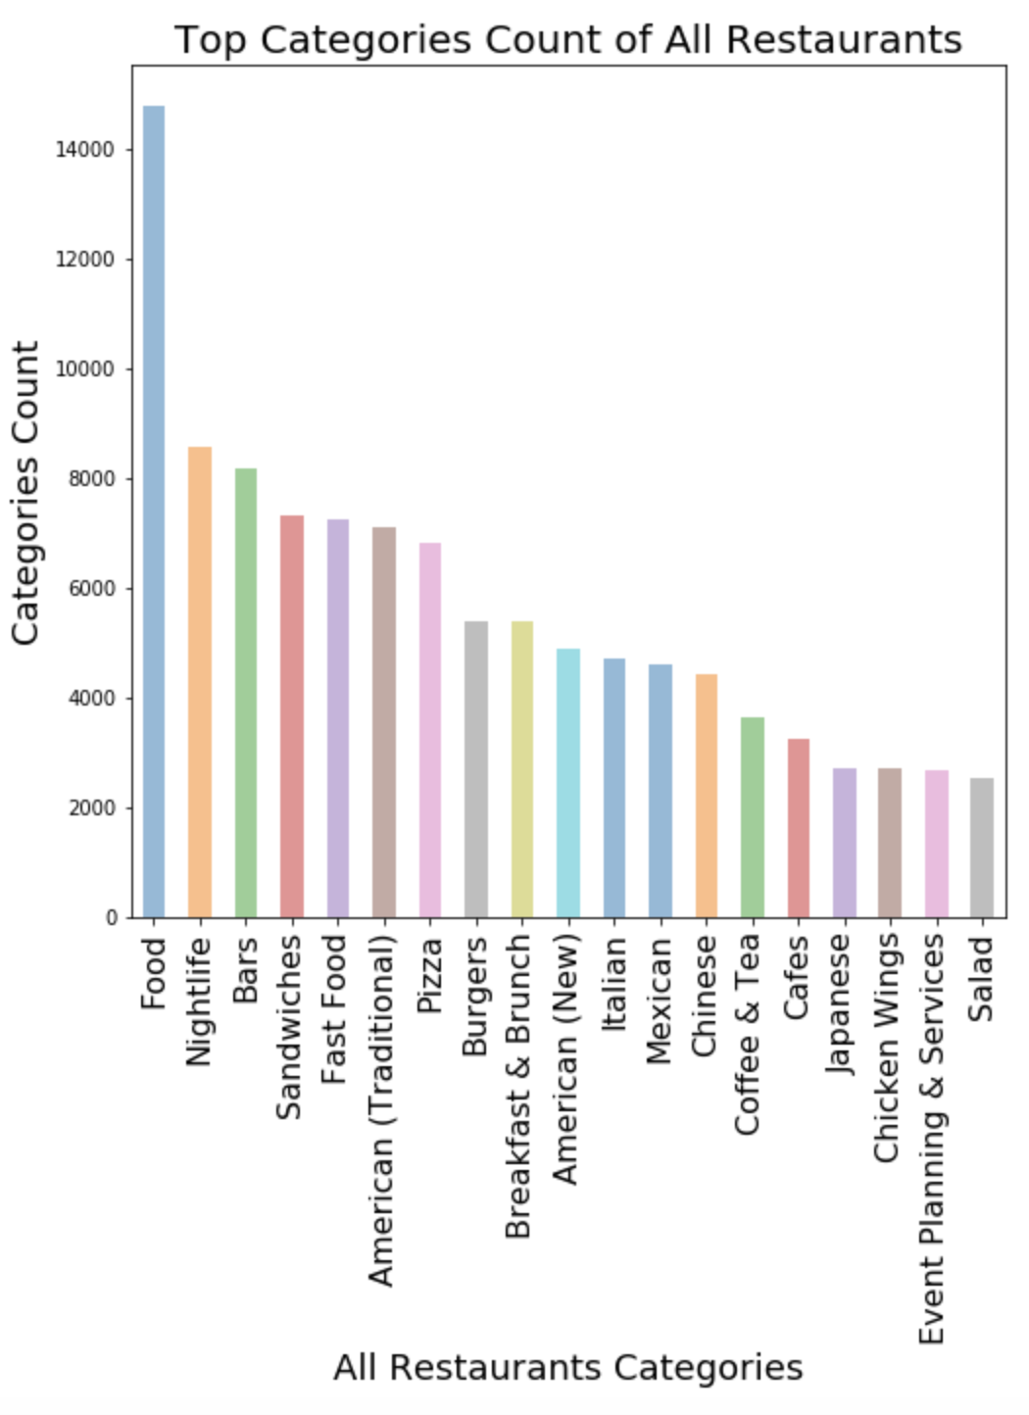
Data Overview——Categories
PART TWO Preliminary Analysis

Slide 10
Data Overview——Cleaned-up Data
PART TWO Preliminary Analysis
File | Original | Cleaned-up Bar Business
Business | 192,609 | 8,155
Review | 6,685,900 | 946,522
User | 1,637,138 | 453,004
Tip | 1,223,094 | 170,127

Slide 11
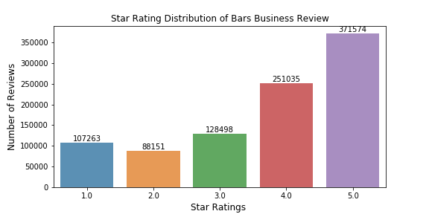
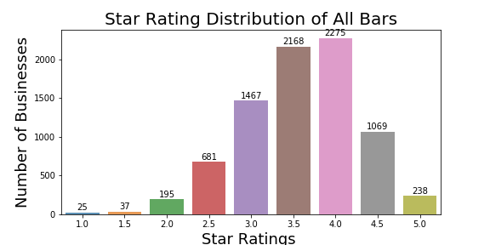
Data Overview——Star Rating
PART TWO Preliminary Analysis

Slide 12
Text Cleaning
PART TWO Preliminary Analysis
• Translation
• Negative Postfix Transformation
• Tokenization
• Removing Punctuation
• Removing Stop Words • Converting Text to Lower Case
• Misspelling
• …

Slide 13
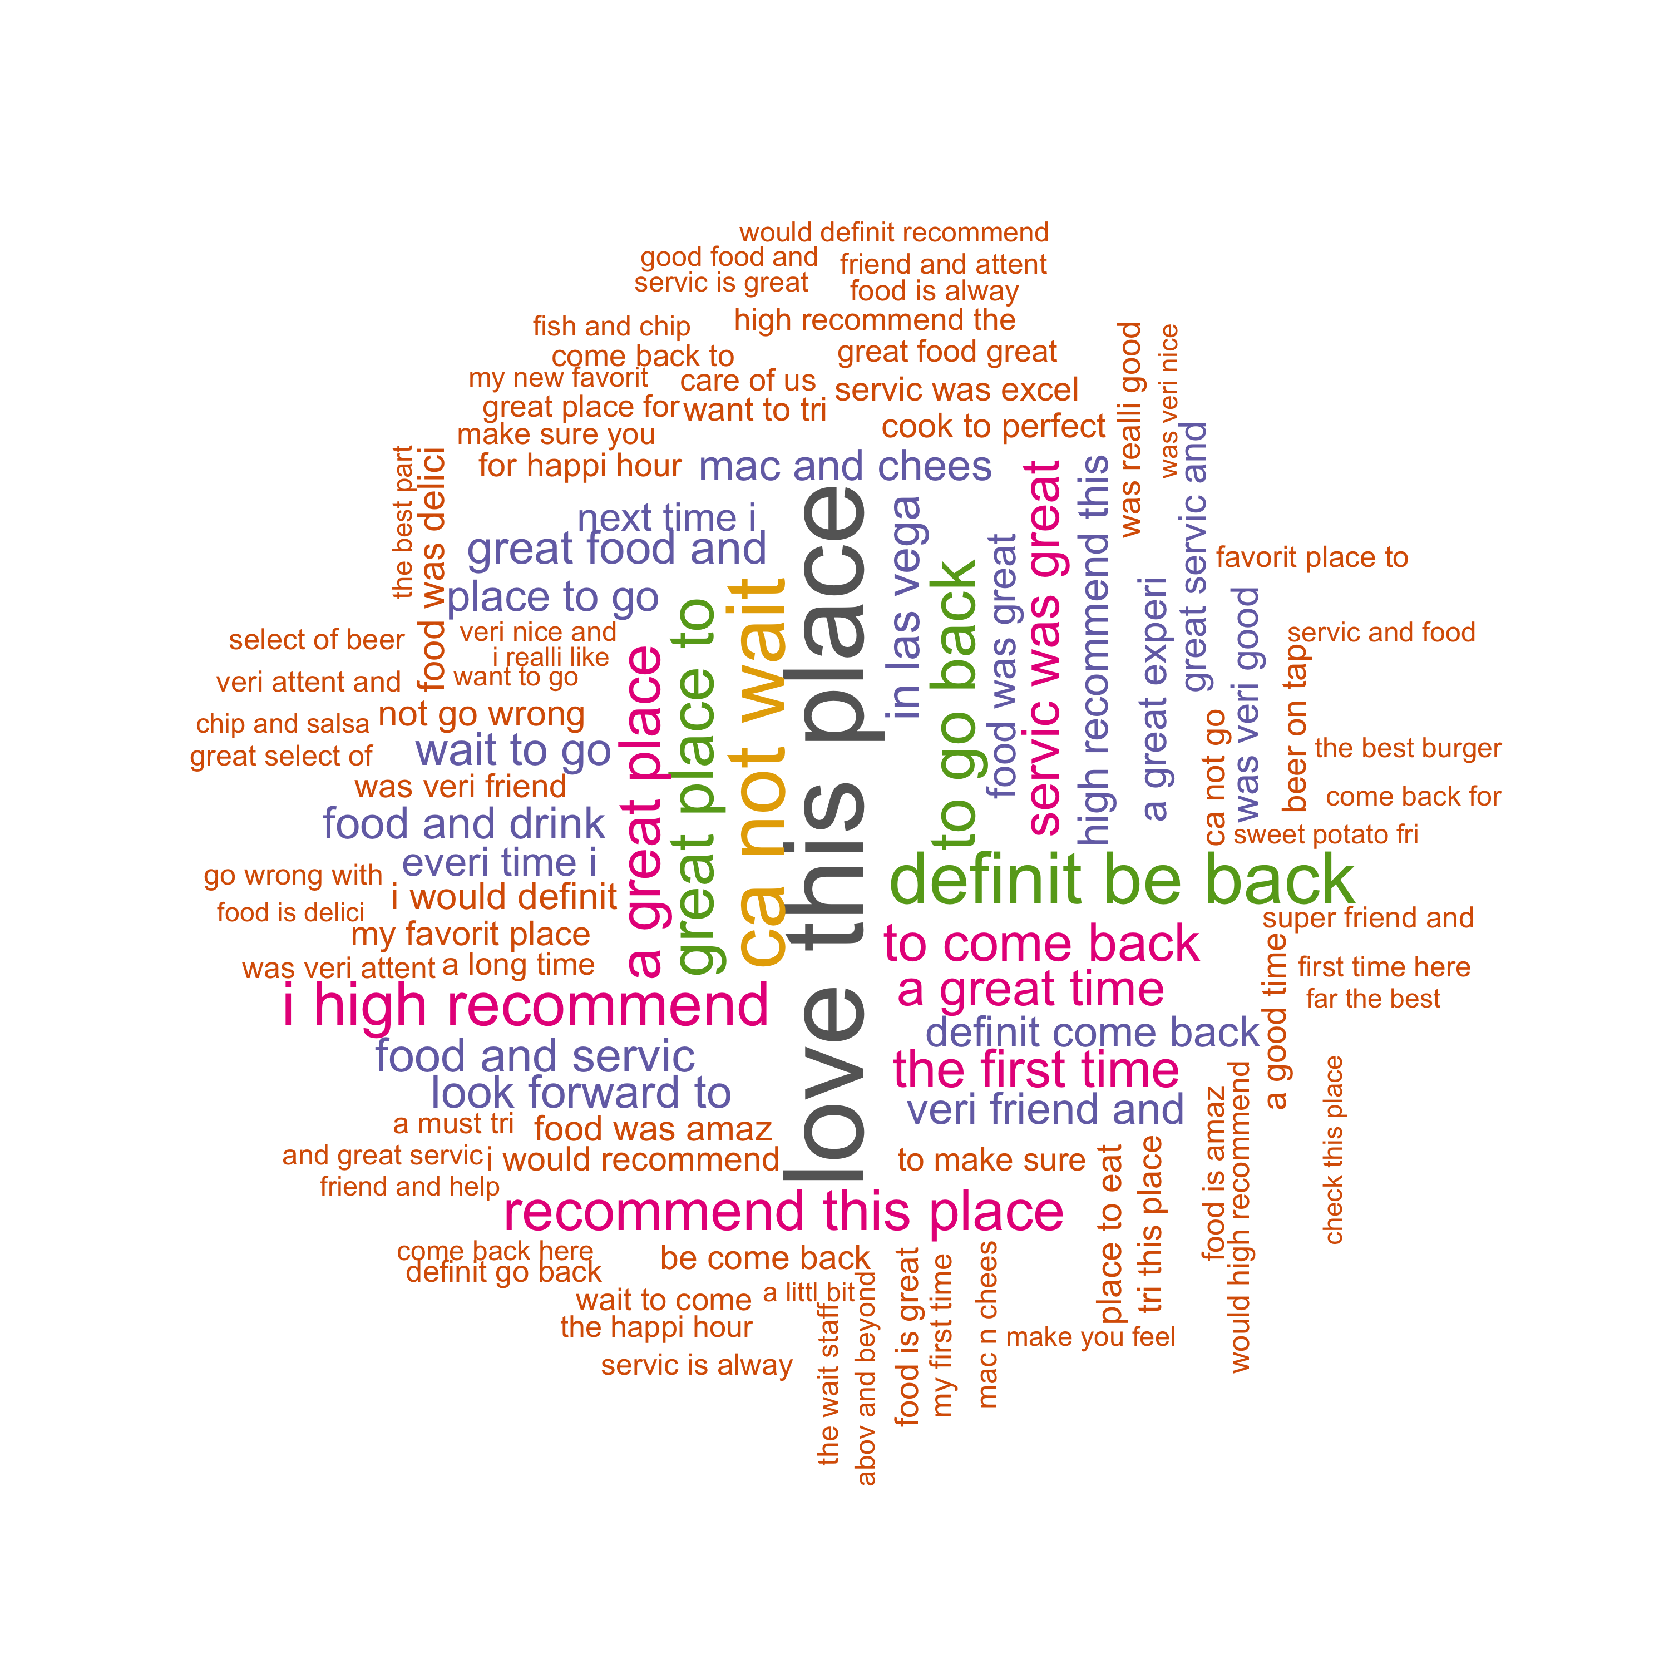
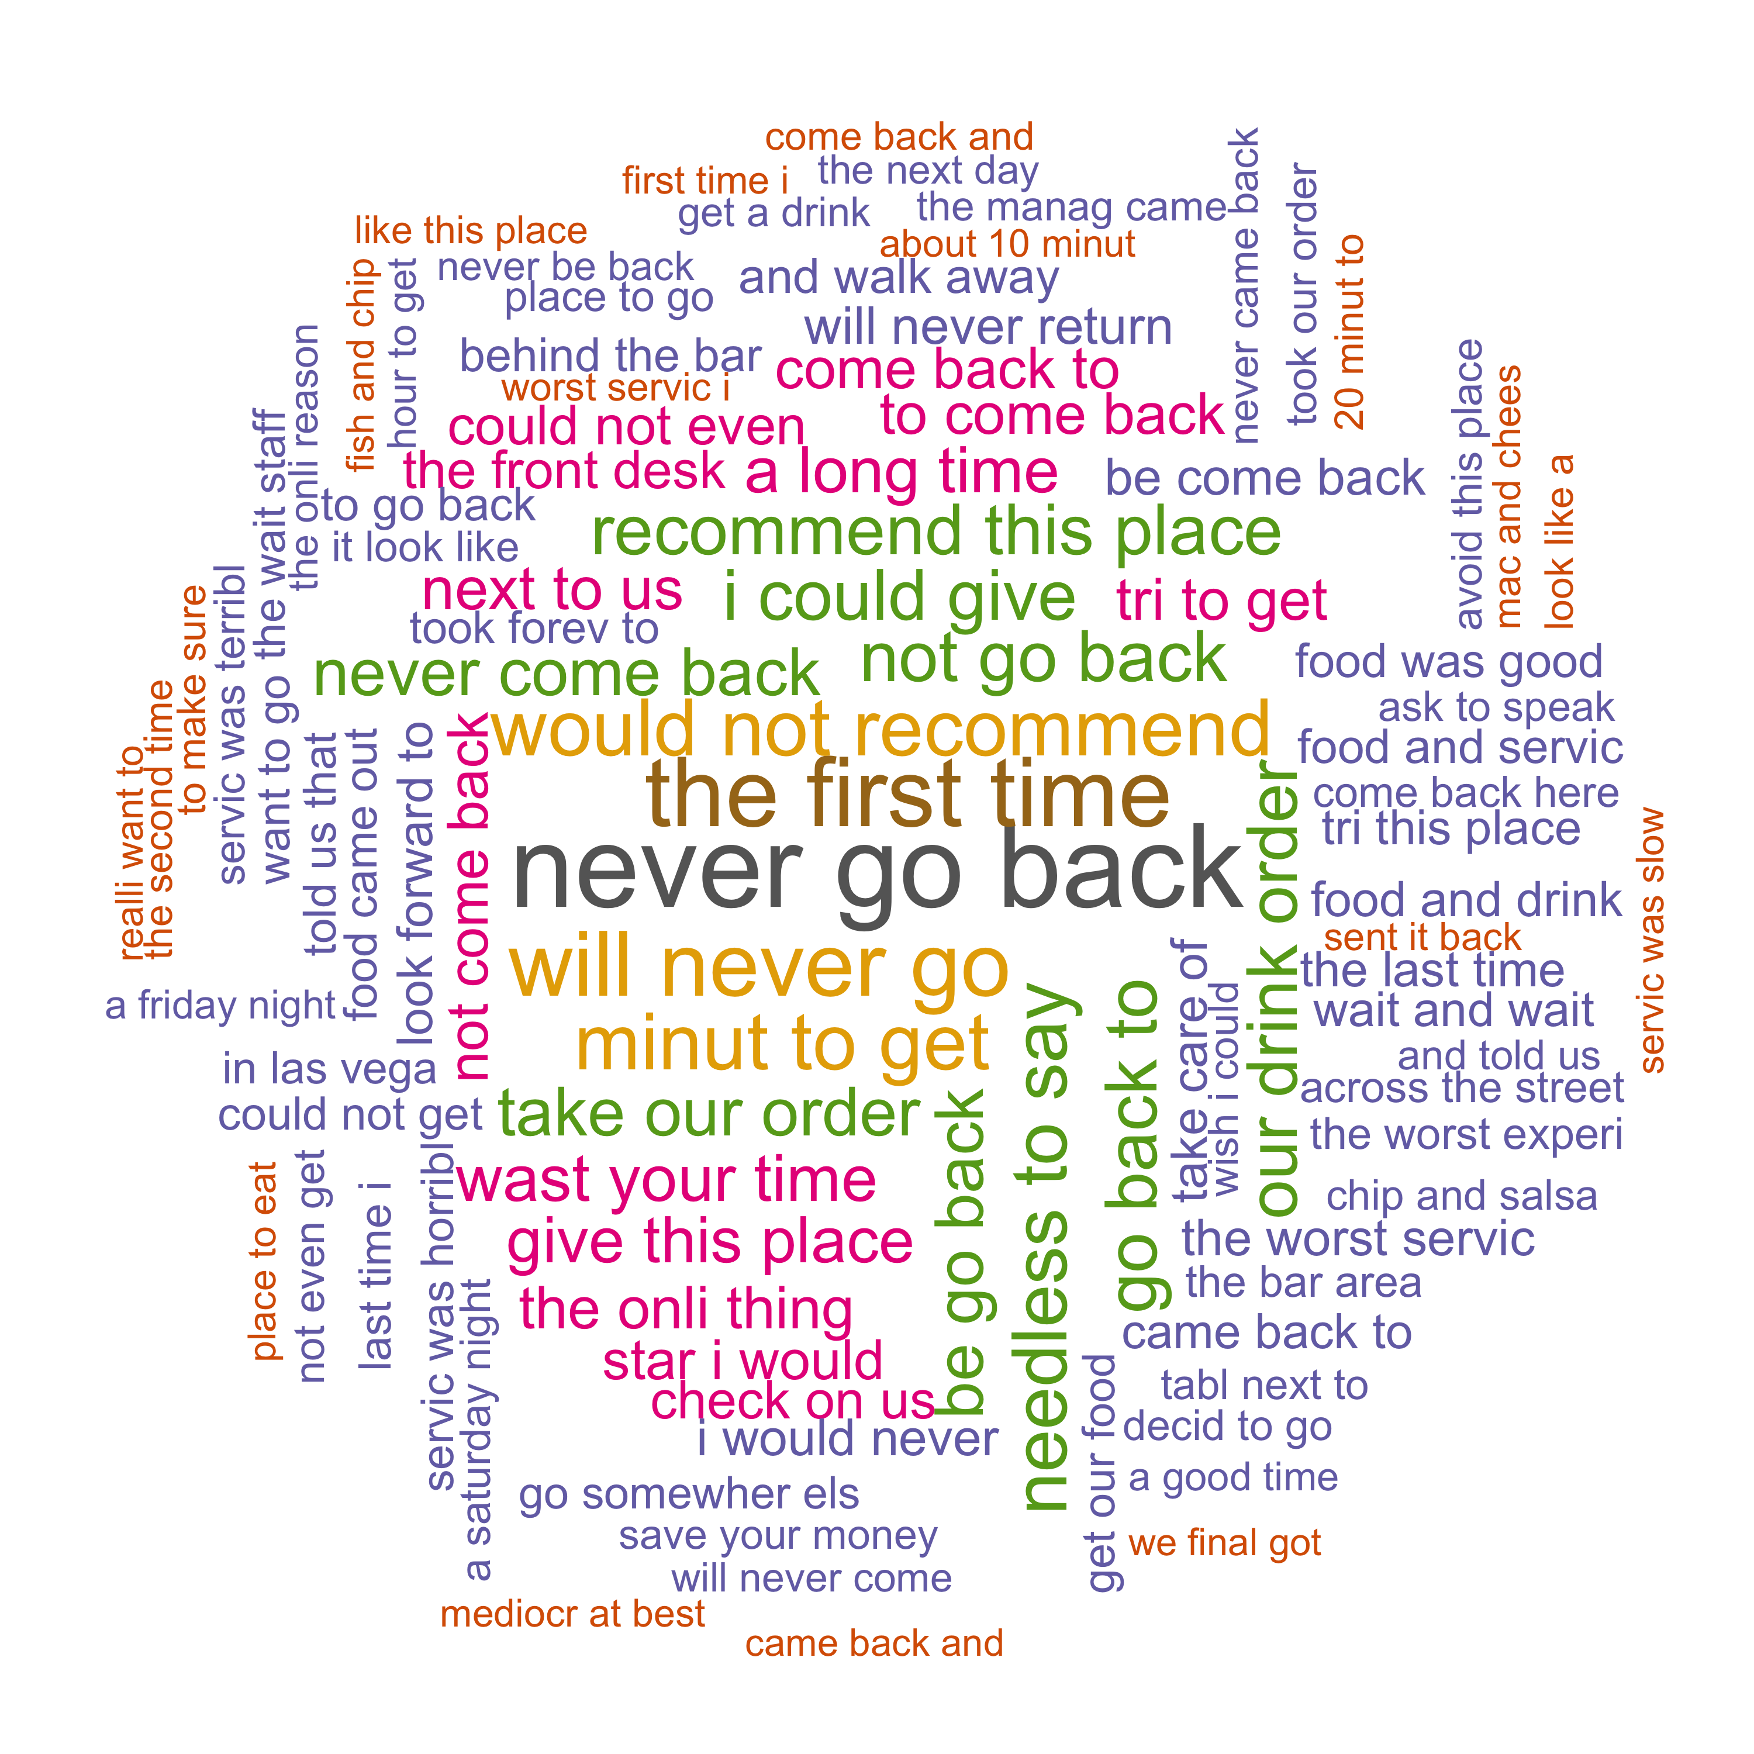
Data Visualization——Word Cloud (3-gram)
PART TWO Preliminary Analysis
5 Star Reviews
1 Star Reviews

Slide 14
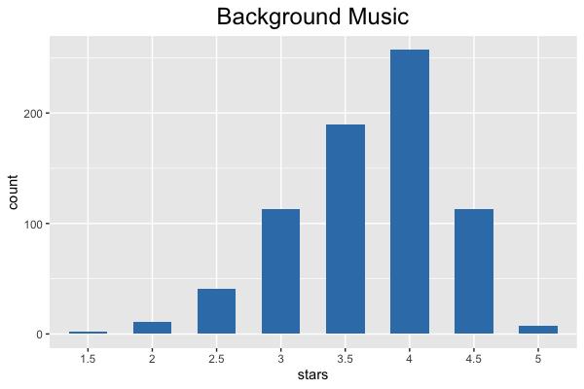
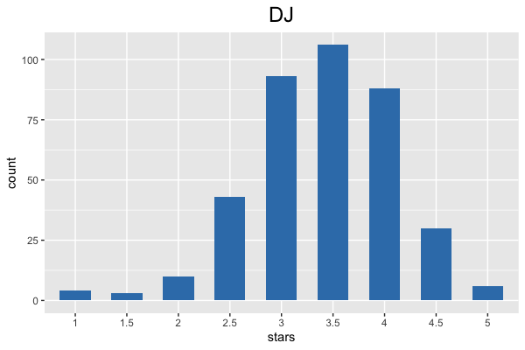
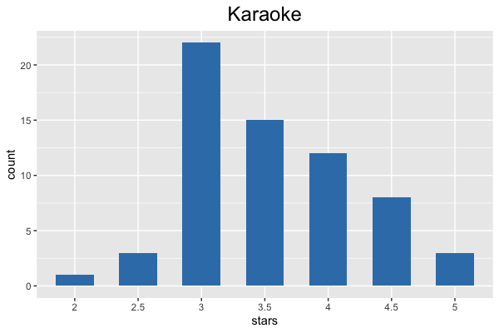
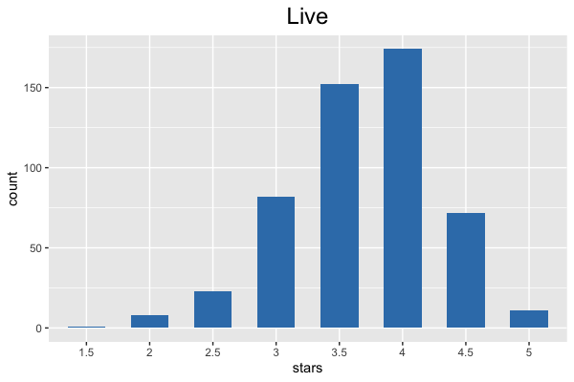
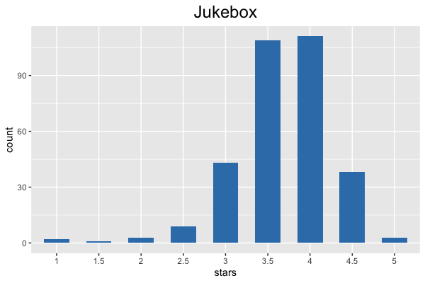
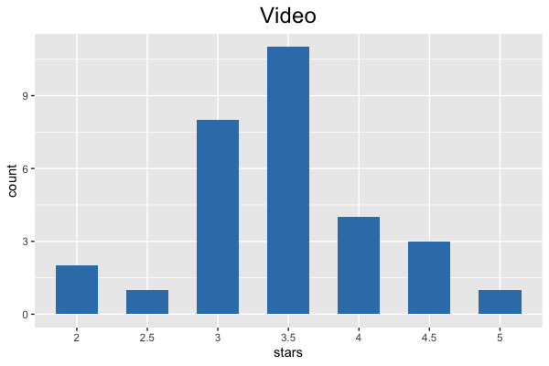
Data Visualization——Attributes (Music)
PART TWO Preliminary Analysis

Slide 15
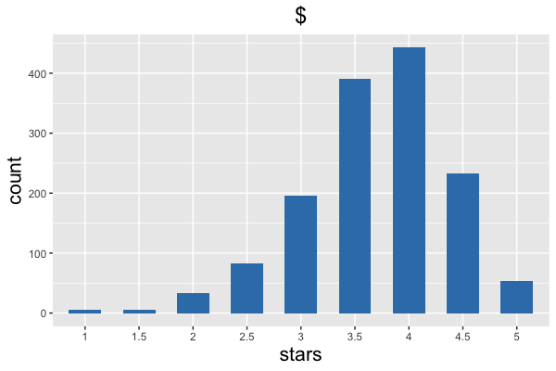
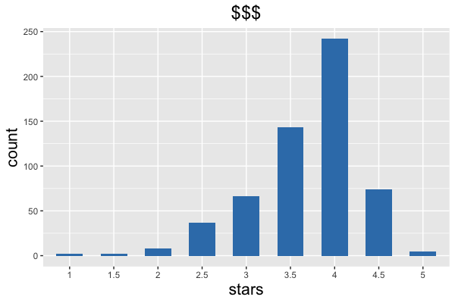
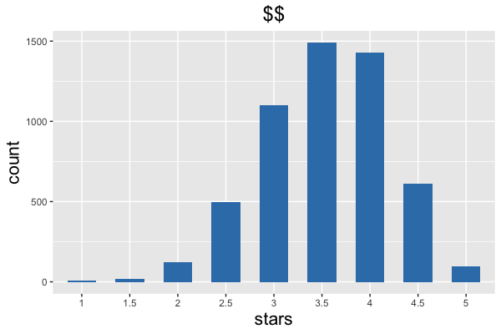
Data Visualization——Attributes (Price)
PART TWO Preliminary Analysis

Slide 16
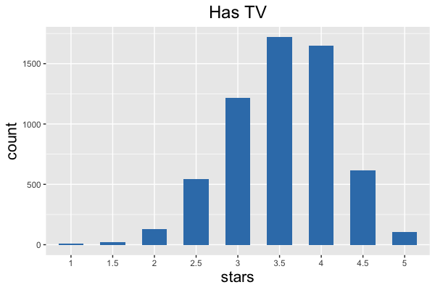
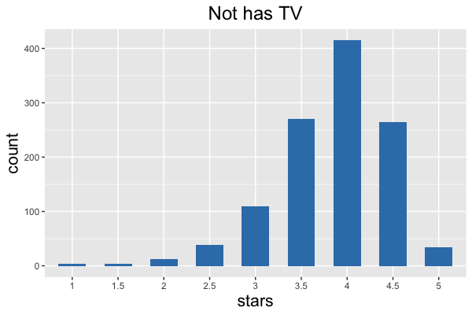
Data Visualization——Attributes (TV)
PART TWO Preliminary Analysis

Slide 17
Feature Extraction——TF-IDF
PART TWO Preliminary Analysis
Service |  | Place |  | Food |  |  | Feeling
Time | Staff | Atmosphere | Spot | Menu | Price | Drinks | Positive | Negative
Wait | Waitress | Music | Outside | Chicken | Cheap | Beer | Great | Terrible
Table | Friendly | Quiet | Inside | Burger | Not Cheap | Craft Beer | Delicious | Bad
Hour | Attentive | Live | Town | Cheese | Priced | Blood Mary | Nice | Awful
Slow | Rude | Ambience | Street | Salad | Expensive | Old Fashion | Good | Disappointed
Busy | Helpful | Not Clean | Parking | Fries | Affordable | Cocktails | Love | Crowded

Slide 18
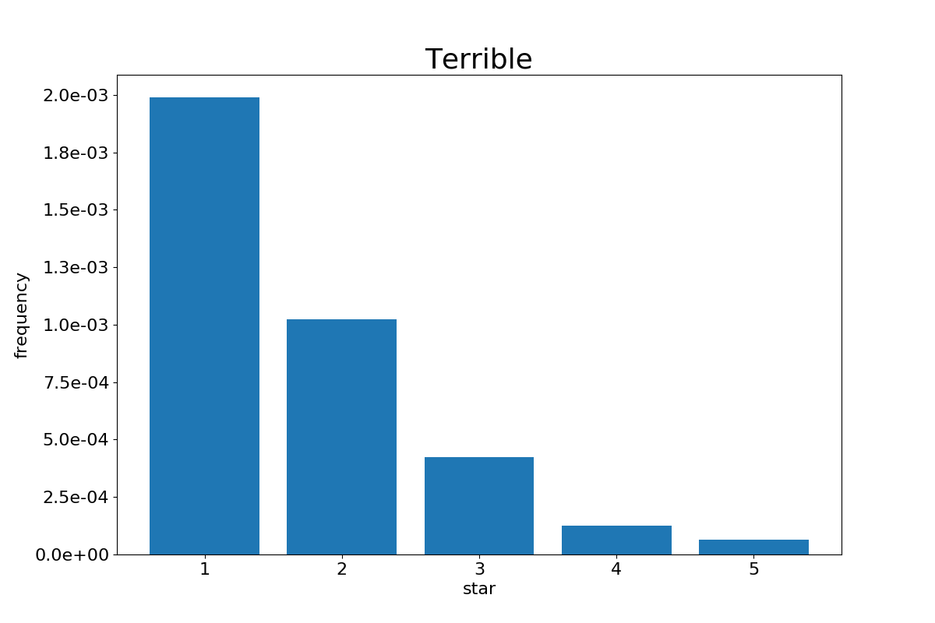
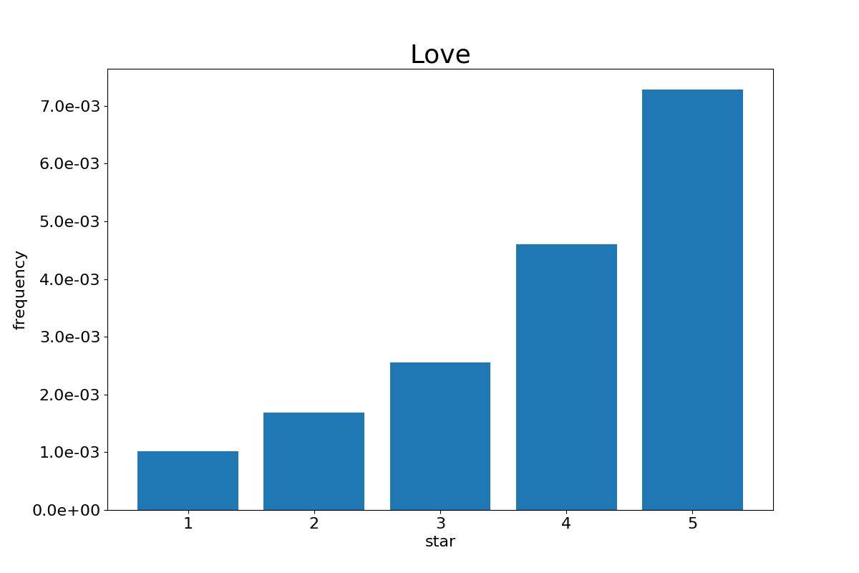
Feature Extraction——TF-IDF
PART TWO Preliminary Analysis

Slide 19
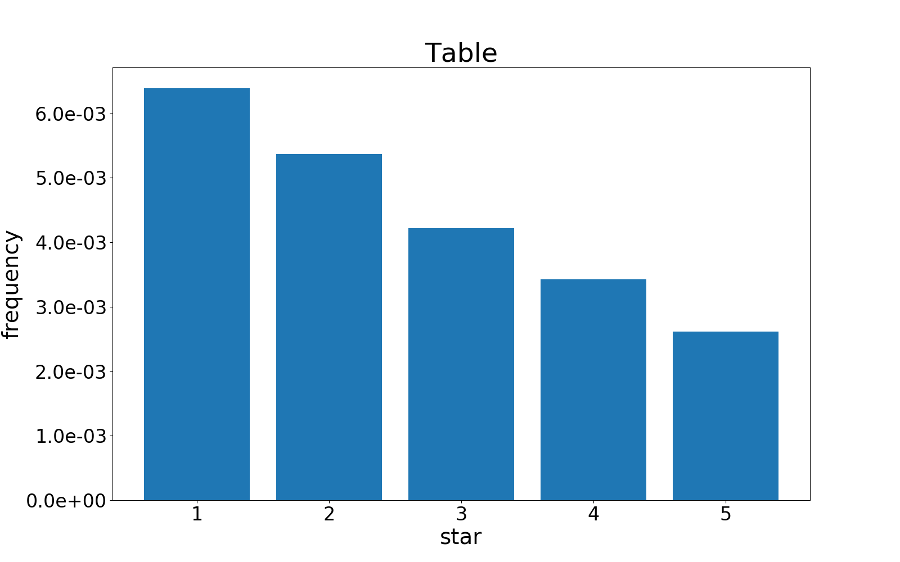
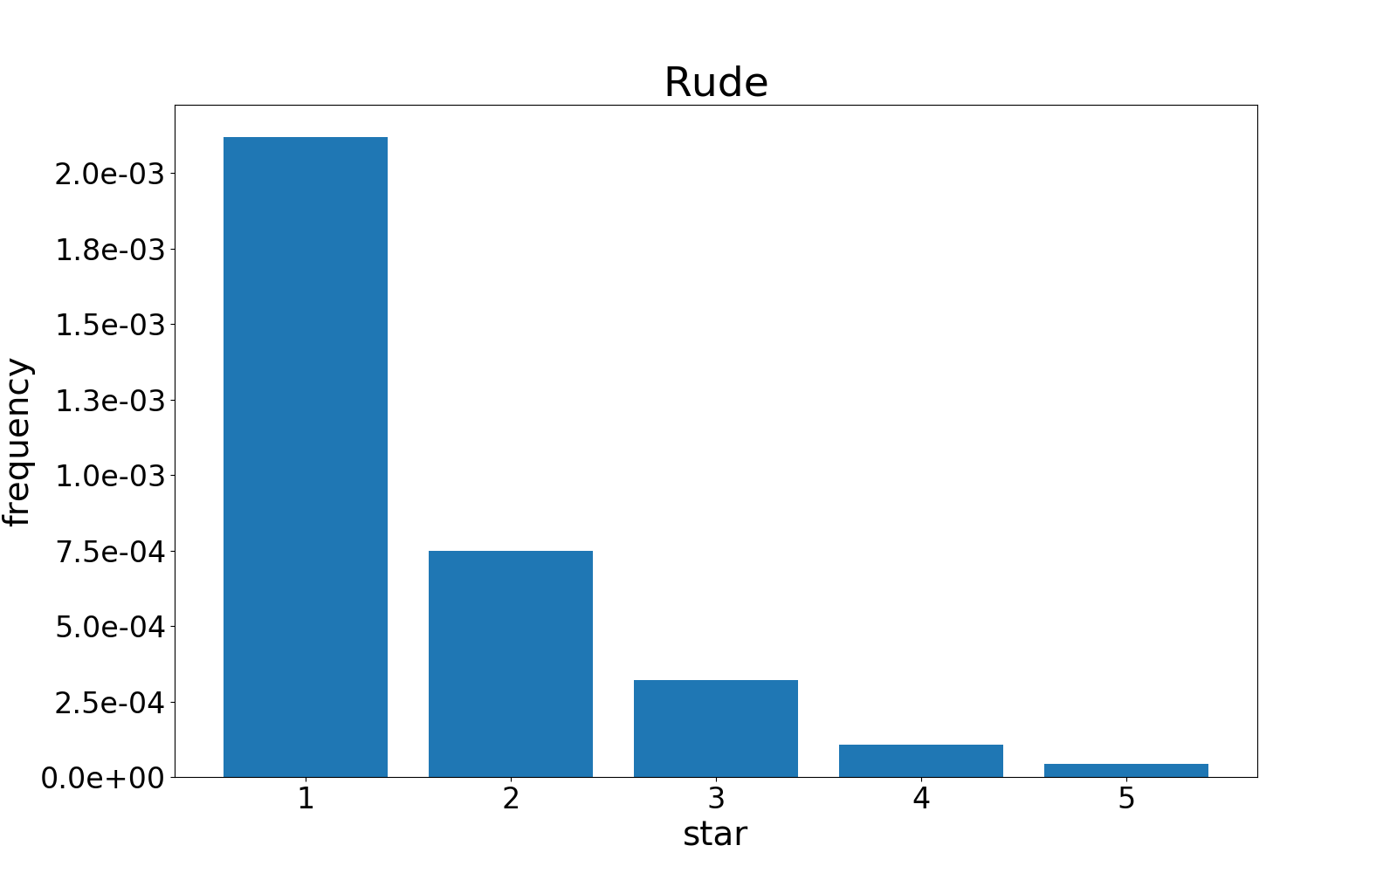
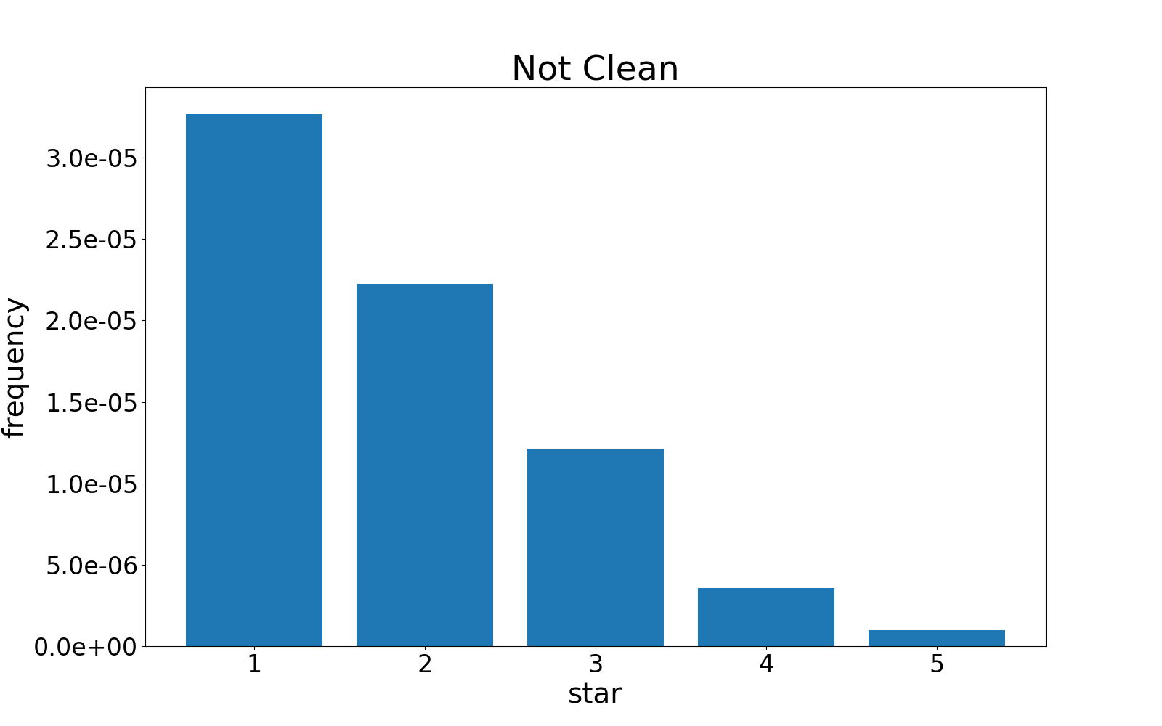
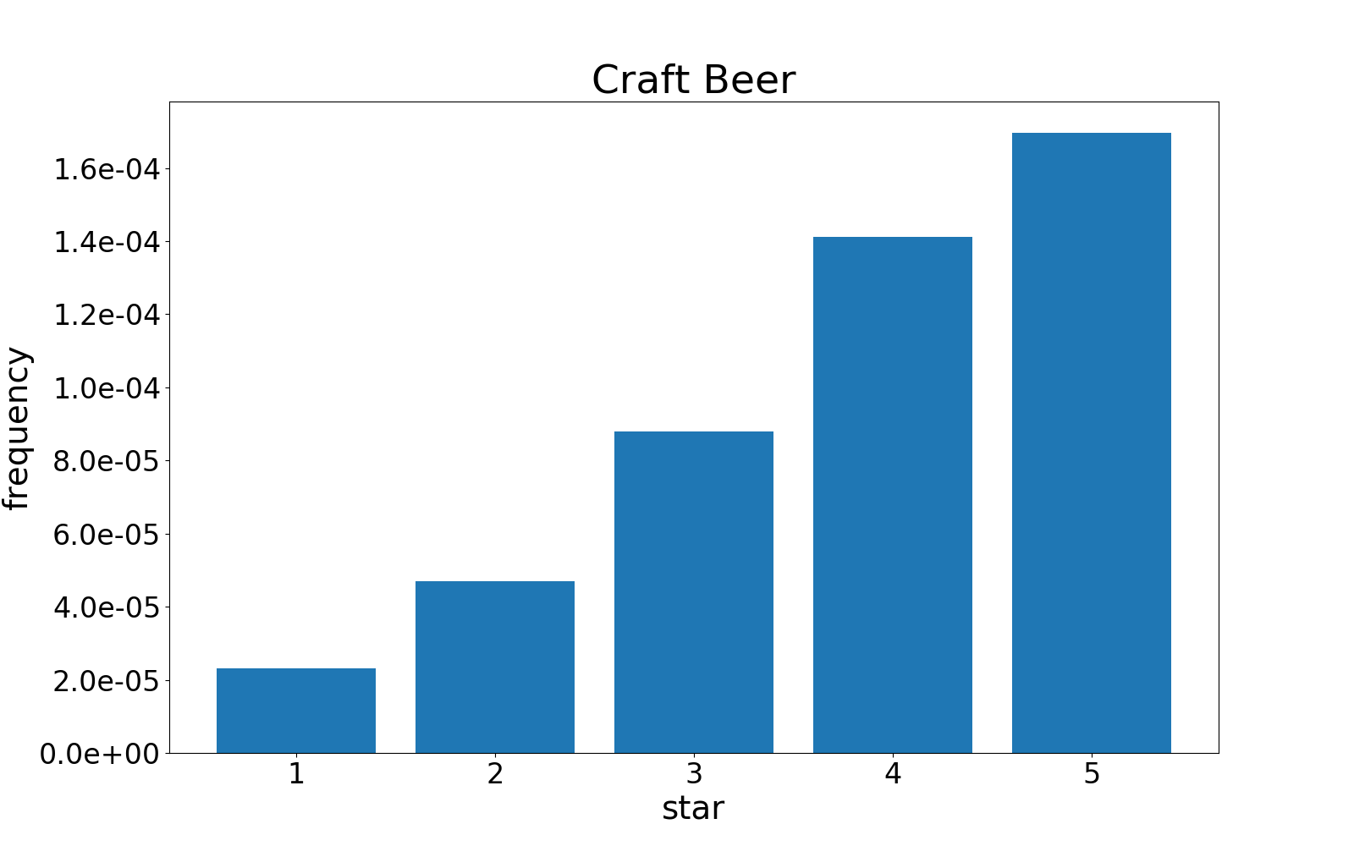
Feature Extraction——TF-IDF
PART TWO Preliminary Analysis

Slide 20
Future Work
PART TWO Preliminary Analysis
Feature Extraction
Shiny
App
Topic Model
Evaluation
Diagnostics

Slide 21
University of Wisconsin Madison
THANKS FOR WATCHING
PRESENTED BY GROUP 2

